Slide 1
Neural Networks &
Genetic Algorithms
Bujor Pavaloiu

Slide 2
Content
1. Artificial Intelligence, Machine Learnig, Connectionist paradigm
2. McCulloch & Pitts neuron model. Perceptron
3. Adaptive Linear Neurons
4. Feed-Forward Neural Networks, Backpropagation
5.,6. Deep Learning
7. Competitive learning Kohonen Self-Organizing Networks
8.,9. Genetic Algorithms
Neural Networks & Genetic Algorithms

Slide 3
Genetic Algorithms
Genetic algorithms are a family of search algorithms inspired by the principles of evolution in nature.
By imitating the processes of reproduction and natural selection, the genetic algorithms can produce high-quality solutions for various problems involving search, optimization and learning.
They are part of the Evolutionary Computation.
Neural Networks & Genetic Algorithms

Slide 4
Darwinian evolution
The principles of the Darwinian evolution:
Variation - The features of individuals vary inside a given population.
Inheritance – (Some) features are passed from parents to the offspring.
Selection – The individuals from a given population are fighting to survive and for resources. The ones having the better adapted features will survive and produce more offspring for the next generation.
Neural Networks & Genetic Algorithms

Slide 5
Genetic Algorithms
Genetic algorithms seek to find the optimal solution for a given problem.
Darwinian evolution maintains a population of individual specimens, but genetic algorithms maintain a population of candidate solutions, called individuals, for that given problem.
These candidate solutions are iteratively evaluated and used to create a new generation of solutions.
Neural Networks & Genetic Algorithms

Slide 6
Genetic Algorithms
Those who are better at solving this problem have a greater chance of being selected and passing their qualities to the next generation of candidate solutions.
When generations are changing, candidate solutions get better at solving the problem at hand.
The evolution of GA is a process that can be performed in parallel.
Neural Networks & Genetic Algorithms

Slide 7
Terms
Gentotype – the collection of genes that characterizes the chromosome/individual.
A gene can be a bit in a binary array or an array of coordinates for a n-dimensional vector.
Fitness function is a measure of how able is an individual from a population
Generation – a collection of individuals competing at a given instance in time
Neural Networks & Genetic Algorithms

Slide 8
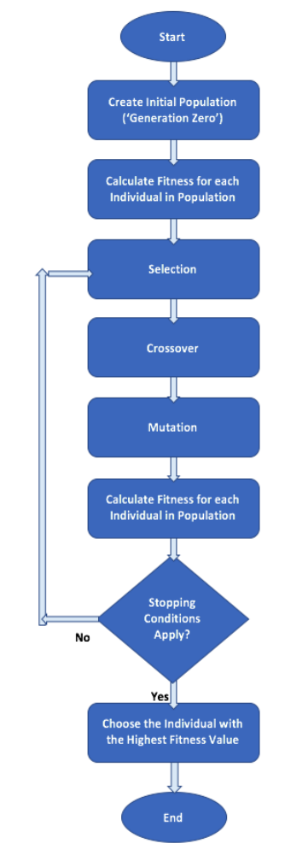
Genetic Algorithm
Neural Networks & Genetic Algorithms

